Slide 1
Diagnostic Service of
Ad-Din Hospital

Slide 2
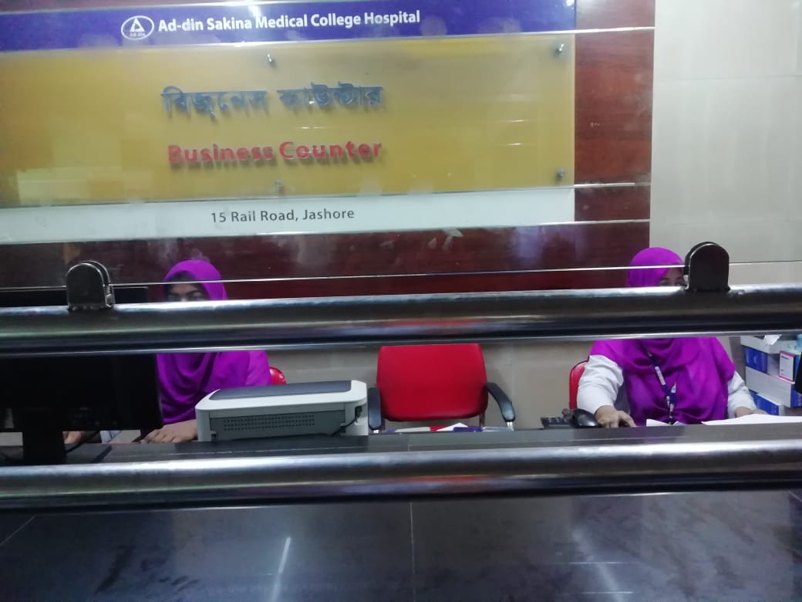
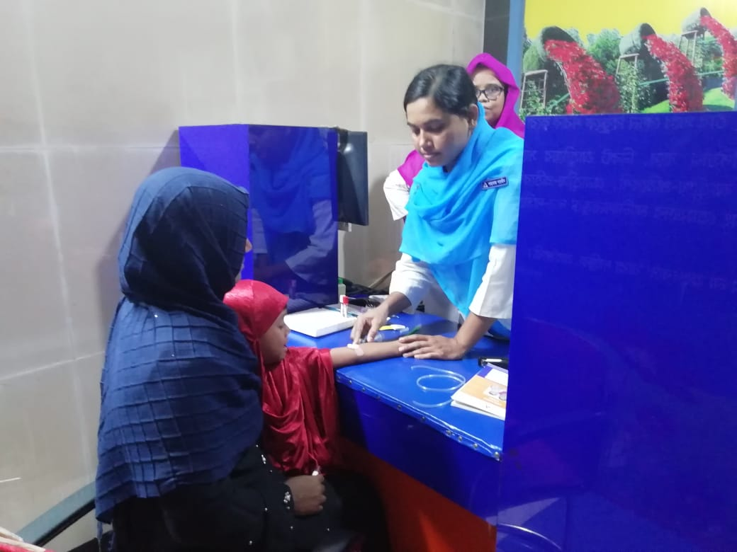
Diagnostic Service of Ad-Din Hospital

Slide 3
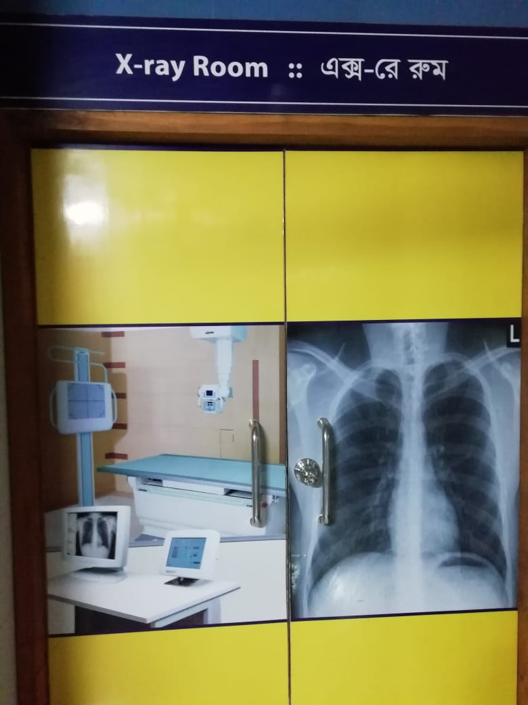
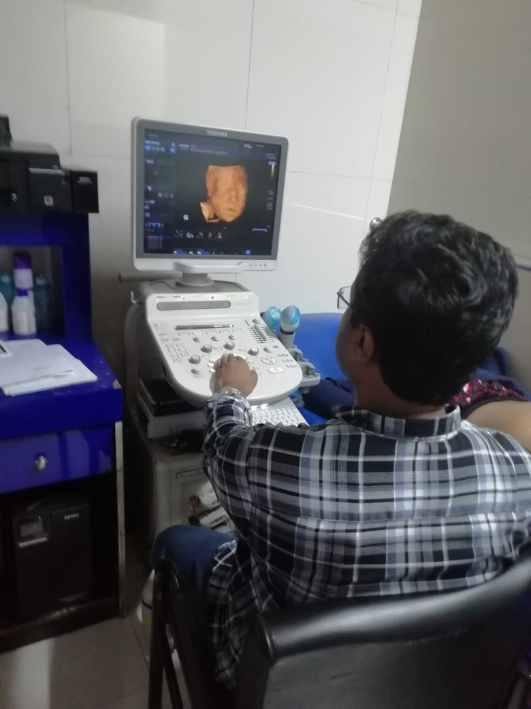
Diagnostic Service of Ad-Din Hospital
X-Ray
4D Ultrasonography

Slide 4
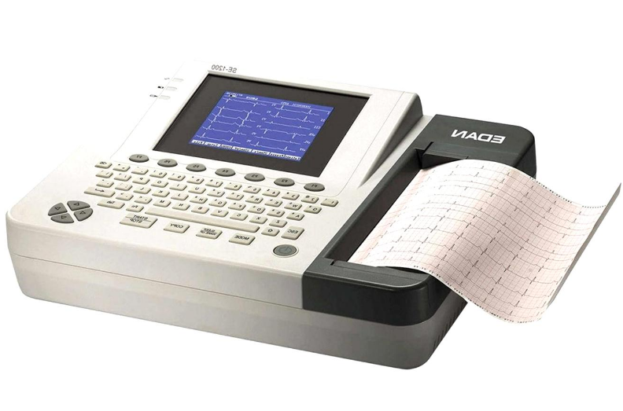
Diagnostic Service of Ad-Din Hospital
ECG Machine

Slide 5
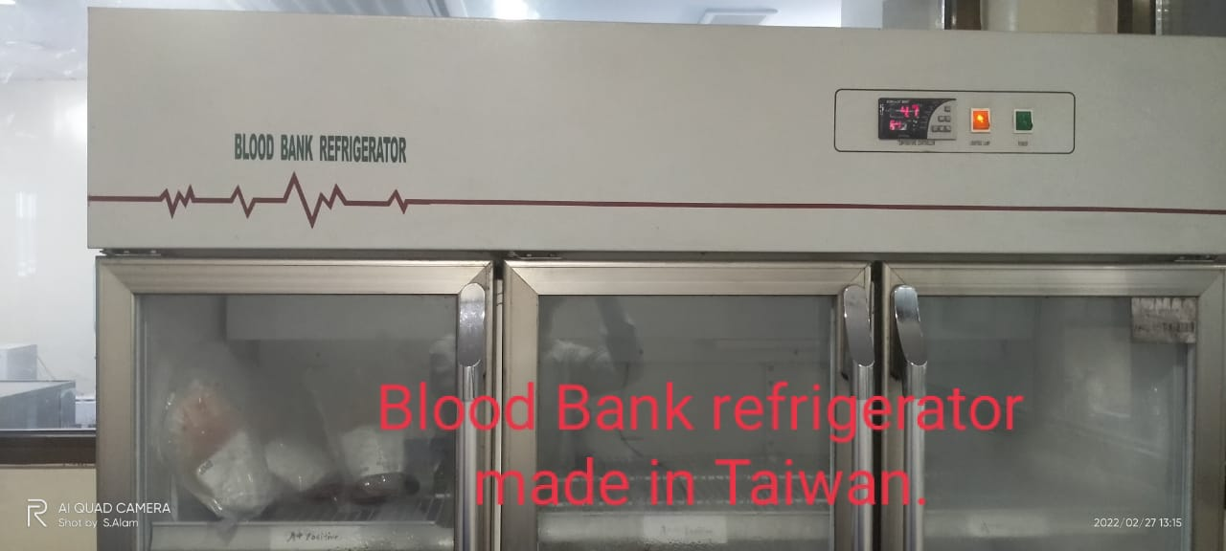
Blood bank of Ad-Din Sokina Medical College Hospital
Blood Bank Refrigerator

Slide 6
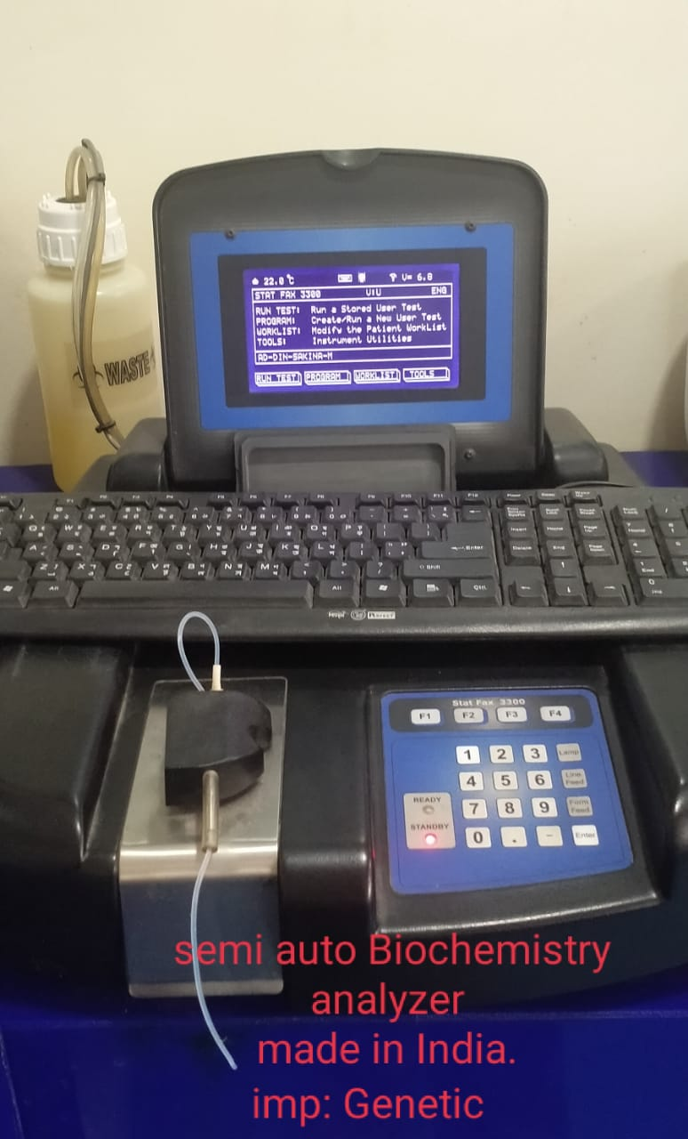
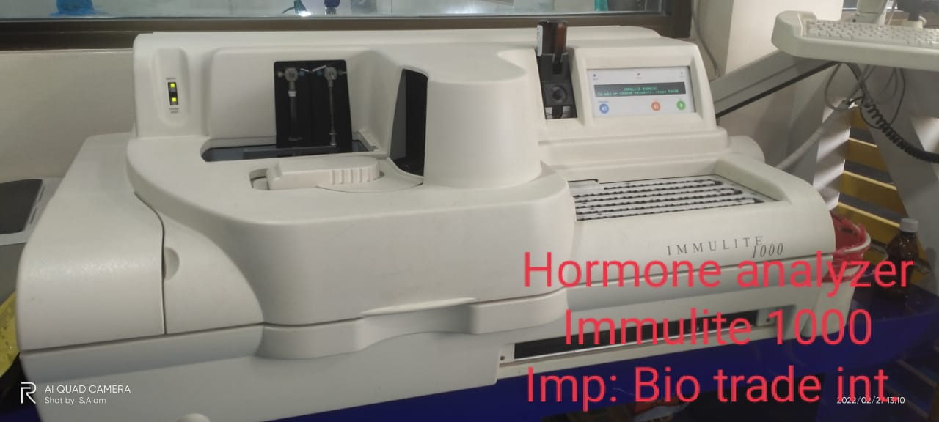
Diagnostic Service of Ad-Din Hospital
Biochemistry Analyzer
Hormone Analyzer

Slide 7
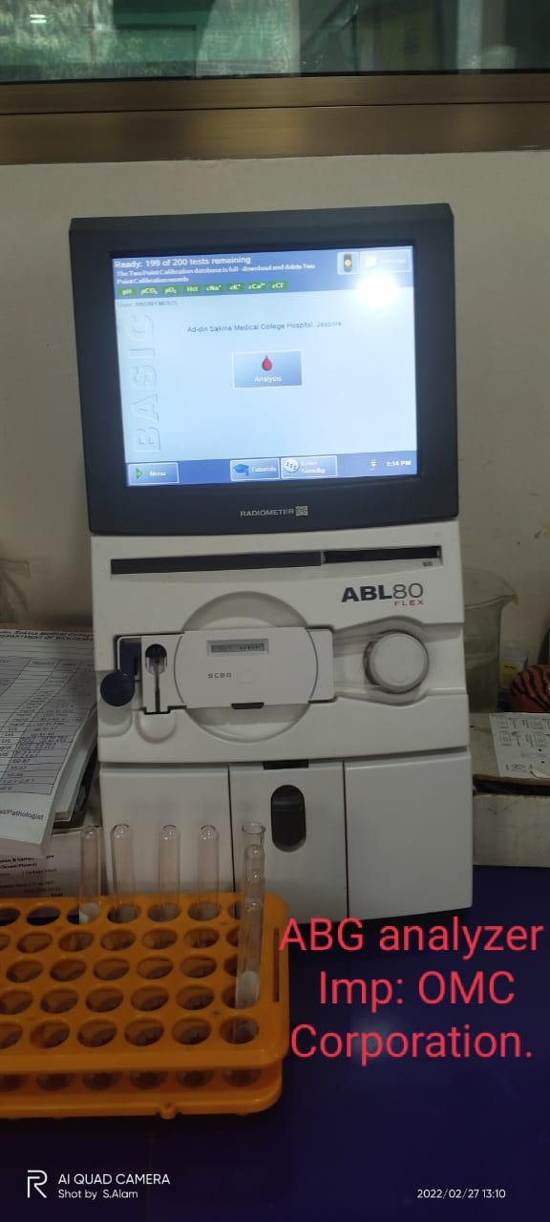
Diagnostic Service of Ad-Din Hospital
ABG Analyzer

Slide 8
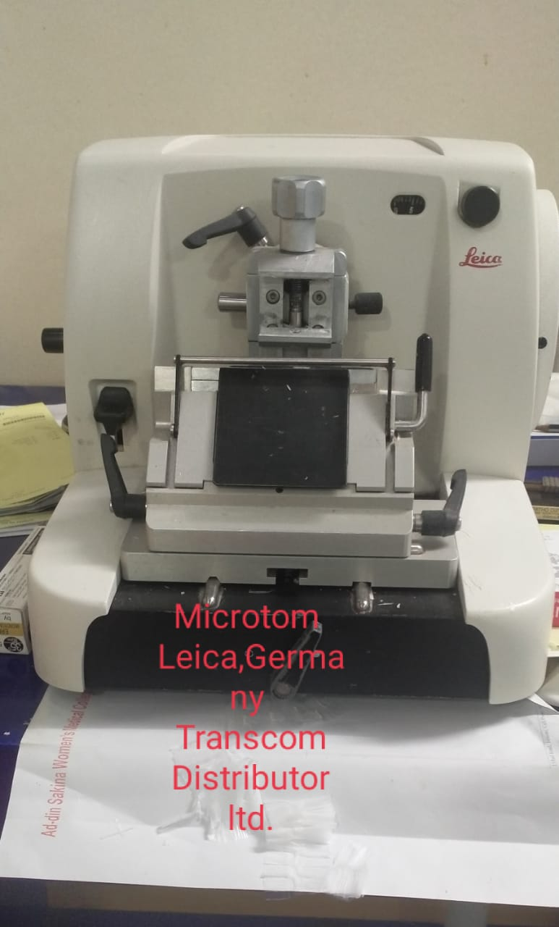
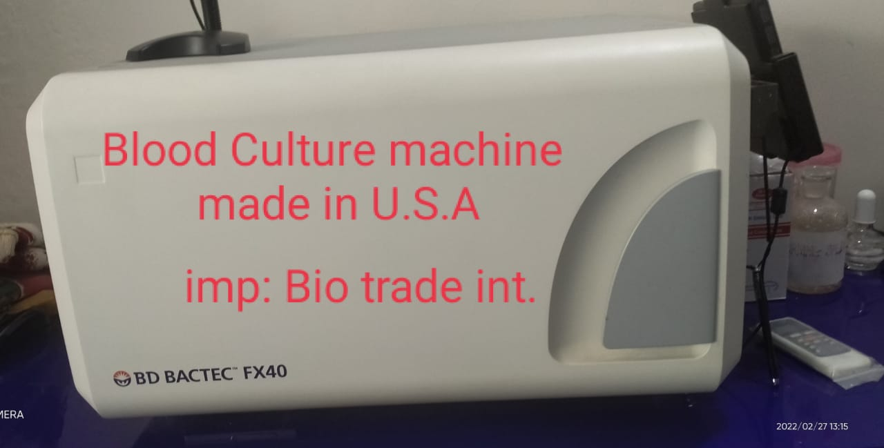
Diagnostic Service of Ad-Din Hospital
Microtomleica
Blood Culture Machine

Slide 9
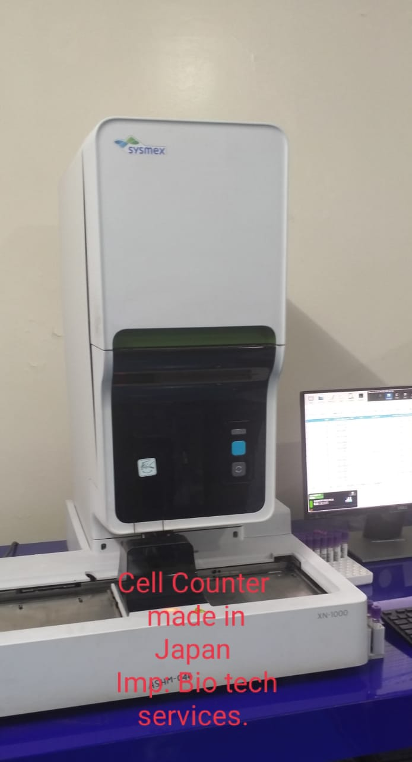
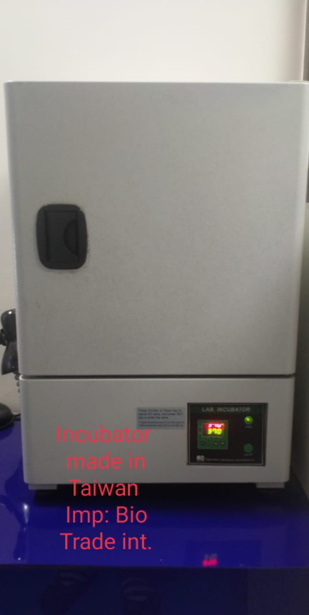
Diagnostic Service of Ad-Din Hospital
Cell Counter
Incubator

Slide 10

Thank You

